Slide 1
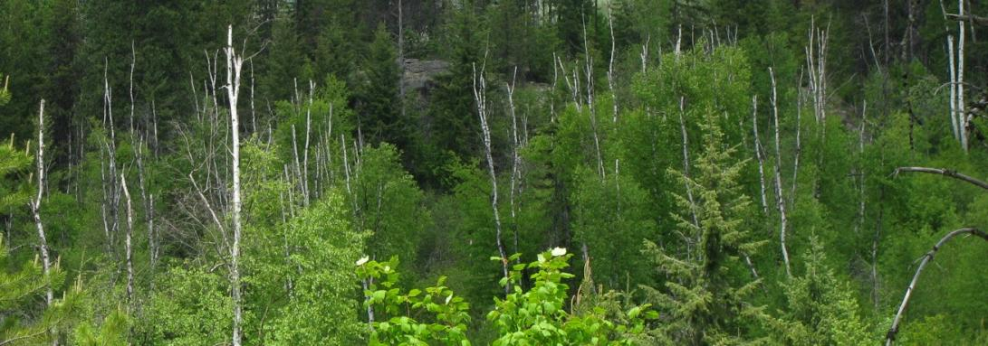
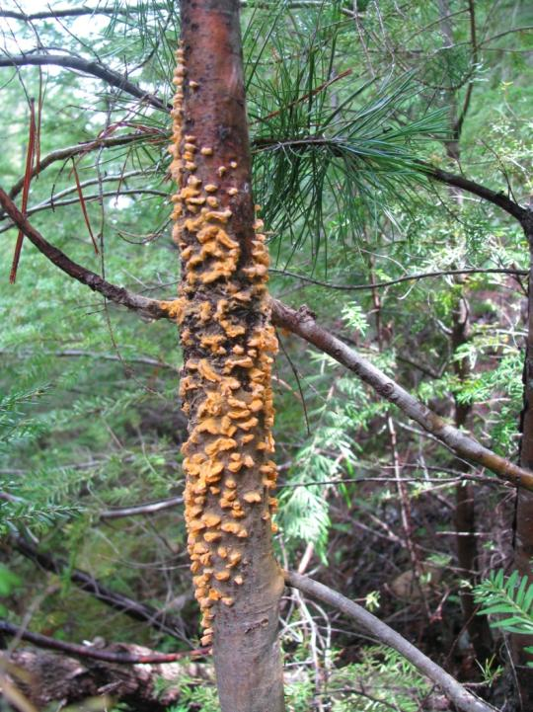
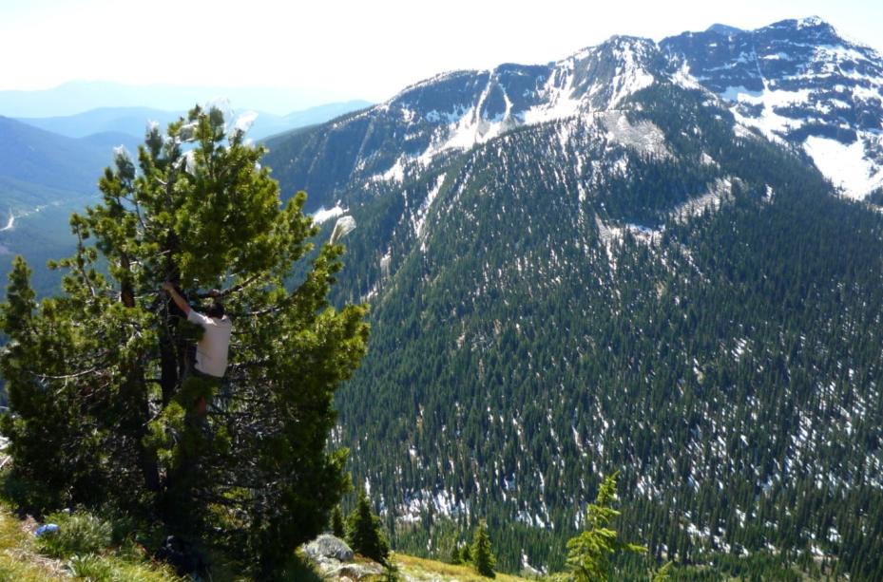
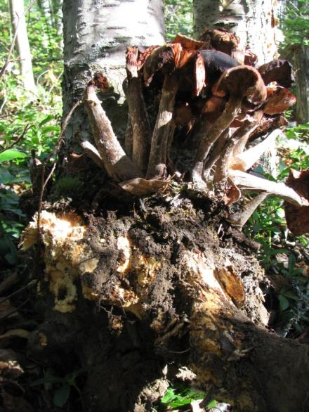
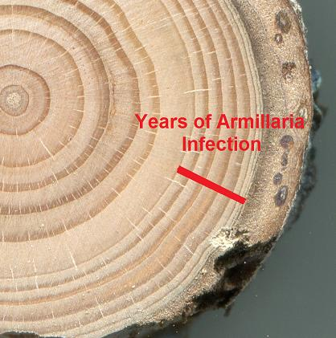

Forest Pathology
Kootenay / Boundary Region
Michael Murray, Ph.D., P.Ag.

Slide 2
Forest Health Factors
Plantations <40 years old
Kootenay Lake TSA
Summary all agents >.5% |  | % of Trees
No detectable damage |  | 43.10
Unknown agent |  | 20.90
Scarring and rubbing |  | 9.10
Stem Disease |  | 6.80
Windthrow |  | 6.00
Snow or Ice |  | 4.30
Porcupine |  | 3.40
White pine weevil (on spruce) |  | 2.40
Lodgepole Terminal Weevil |  | 2.20
Larch Needle Cast |  | 1.60
Gall Rust |  | 1.30
Foliage Disease |  | 1.20
Logging Wounds |  | 1.20
Frost Crack |  | 1.00
Fire |  | 0.90
Mtn Pine Beetle |  | 0.90
Birds |  | 0.80
Commandra Blister Rust |  | 0.70
Root Disease |  | 0.60
Forest Health Factors | Percent of Trees Observed
Abiotic Damage | 4.27
Wildlife Damage | 2.40
Vegetative Competition | 1.16
White Pine Blister Rust (all conifers) | 1.11
All Root Diseases | 0.96
Native Rusts (Gall, Commandra, Stalactiform) | 0.74
Mistletoe | 0.06
Foliar Disease | 0.01
TOTAL | 10.7
Source: Stand Development Monitoring 2008
Source: Young Stand Monitoring (CMI) 2012
Notes:
Stem diseases, most notably non-native blister rust is threatening the very existence of a 2 tree species, whitebark and limber pines.

Slide 3
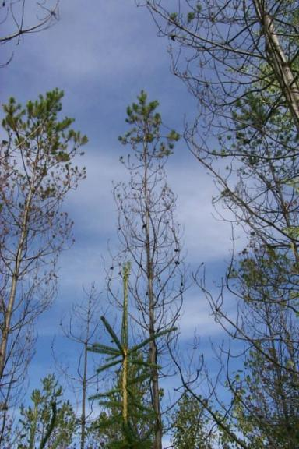
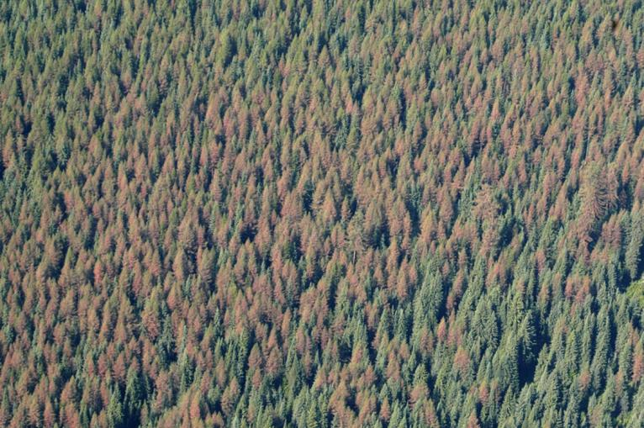
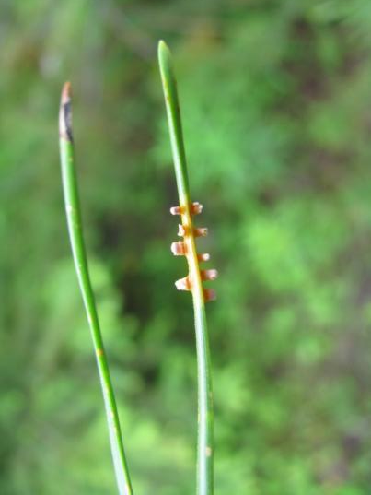
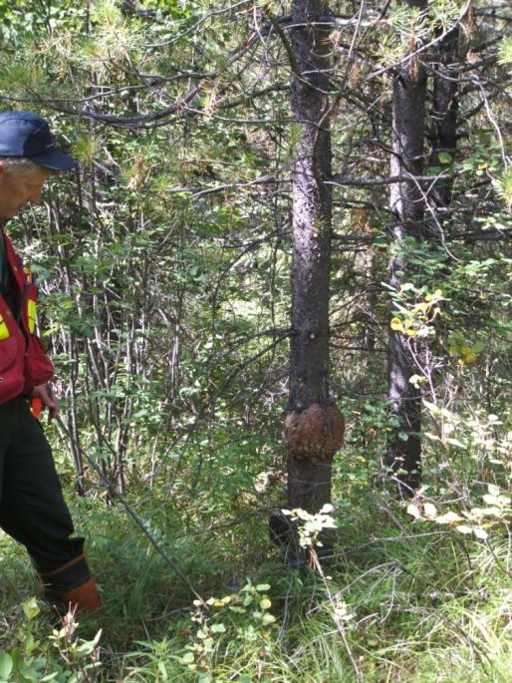
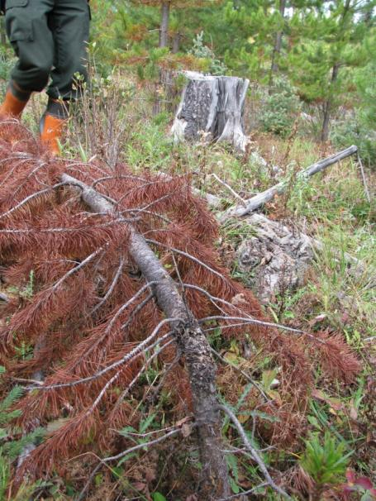
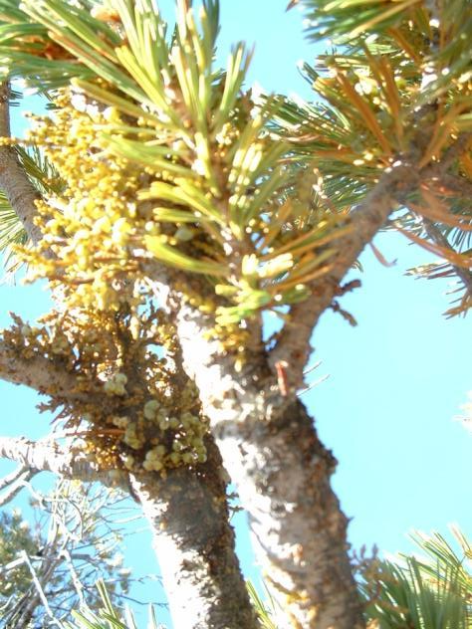
Dothistroma needle blight
Pine Needle Rust
Larch Needle Blight
Stalactiform Rust
Western Gall Rust
Dwarf Mistletoe
Notes:
Koot – species rich. A lot of hosts = a lot of disease & insects.

Slide 4
Source: USDA Forest Service, 2011

Slide 5
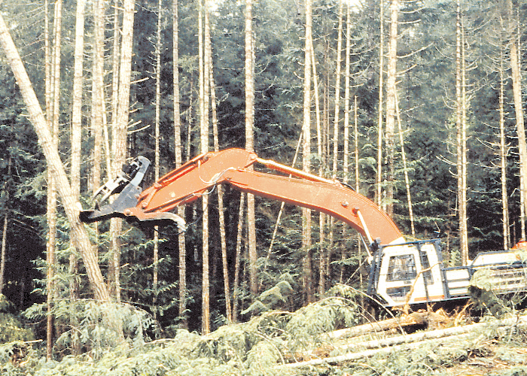
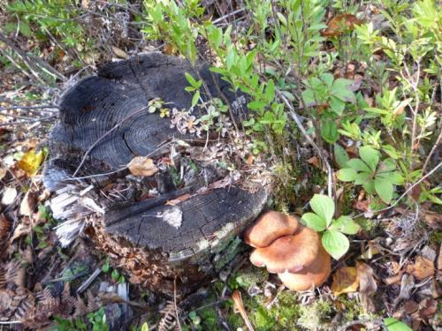
Removal of stumps and roots “can significantly reduce the food base available to the fungus and delay infection of susceptible crop trees” (USFS 2008)
“ Armillaria... can be reduced by mechanical removal of stumps and major roots” (BCFS 2008)

Slide 6
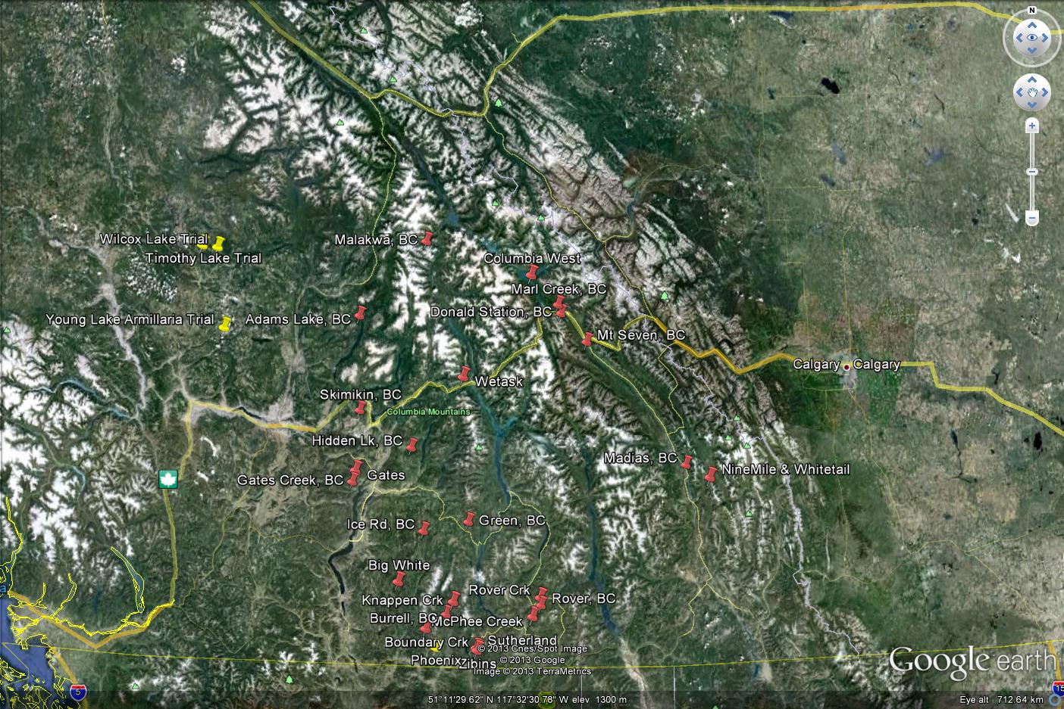
Notes:
SIR = 37 Trials
Variety of Treatments, Establishment Dates, etc.
Due for re-measuring
Most are not replicated.

Slide 7
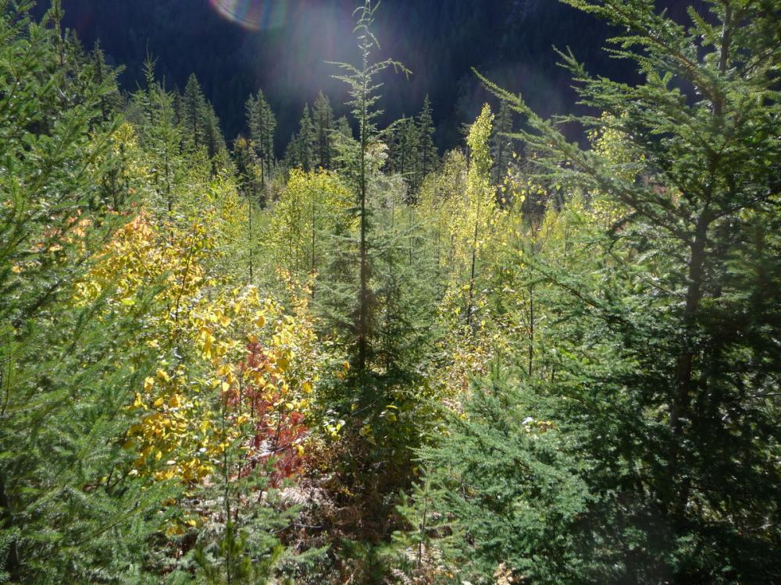
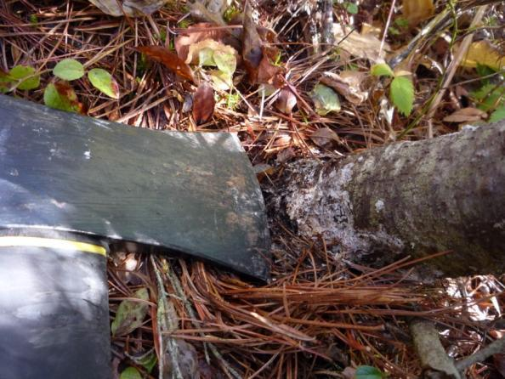
Notes:
Field inventories 2011, 2012, 2013

Slide 8
Preliminary Results
Trial Name | Less Root Disease?*
Columbia West | TBD
Gates | Yes
Knappen Crk. | Yes
McPhee LTSP | Yes
Macaroni (Old Camp) | TBD
Marl Creek | Yes
Ninemile | Yes
Phoenix | Yes
Rover LTSP | Yes
Sutherland Crk. | Yes
Whitetail Brook | TBD
Zibins | Yes
* Not yet tested for statistical significance
Notes:
9/12 Yes
3/12 TBD
Timeline: spring 2014: biological conclusions, 2014+ begin cost-benefit analysis

Slide 9
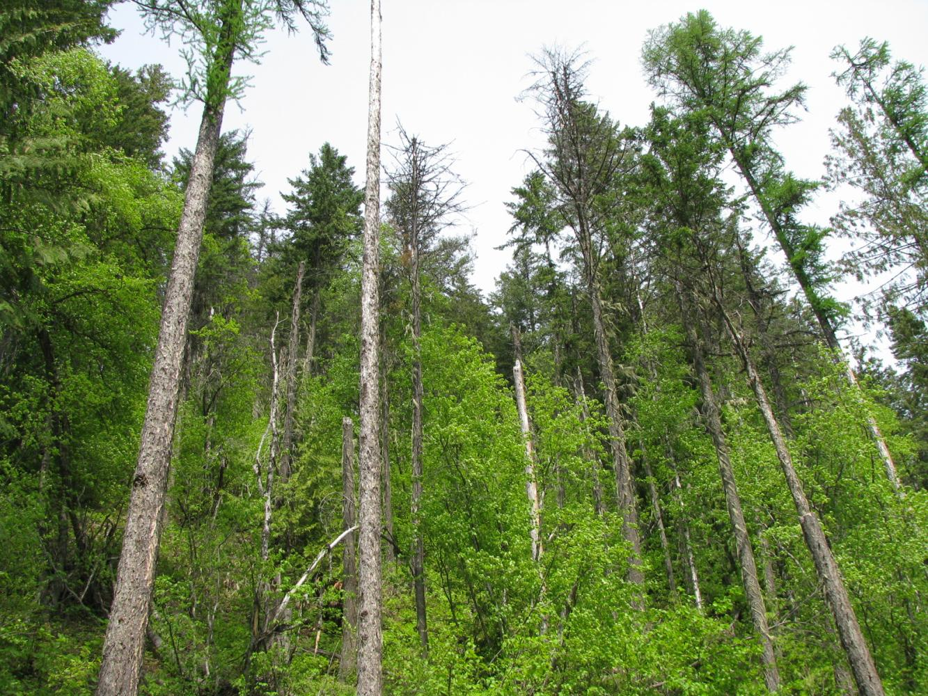
Autumn 2013 | 2013/14 | 2014/15 | 2015/16
Interim Guidelines | Trial Analysis Annual Spread (Paper) | Meta-analysis | Summary (paper) Cost-benefit

Slide 10
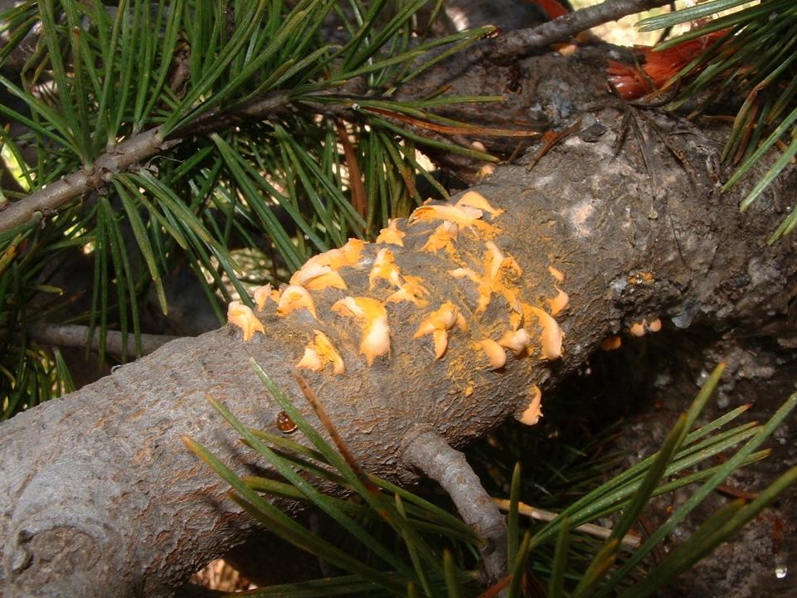
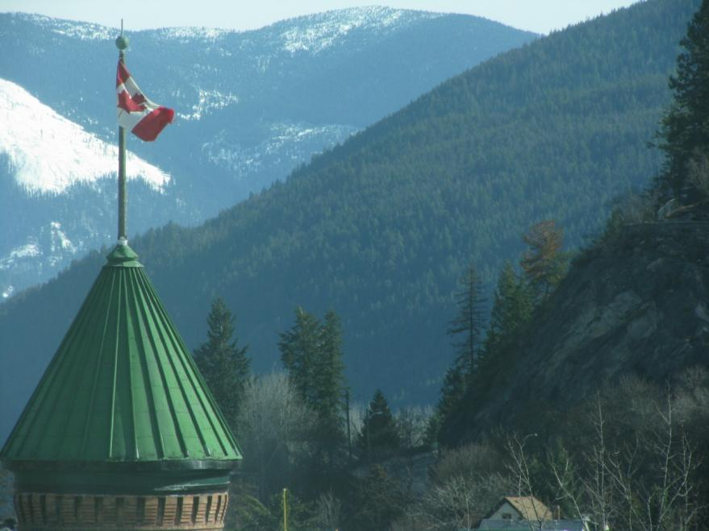
Notes:
#1 in SDM:
Non-native
Impacts one of our most productive trees, white pine. Rarest: limber pine, and ecologically valuable: whitebark pine.

Slide 11
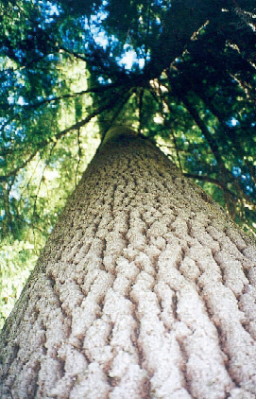
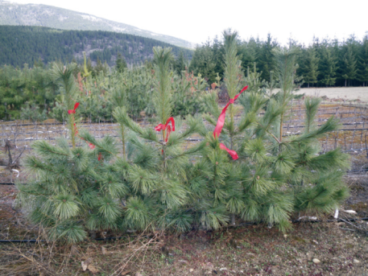
White Pine Health
(Pinus monticola)
Very productive timber species
Broad elevation range
Browse-resisistant
Wildlife value
How much disease-resistance?
Notes:
Burton, Trinity Valley, new pruning trials

Slide 12
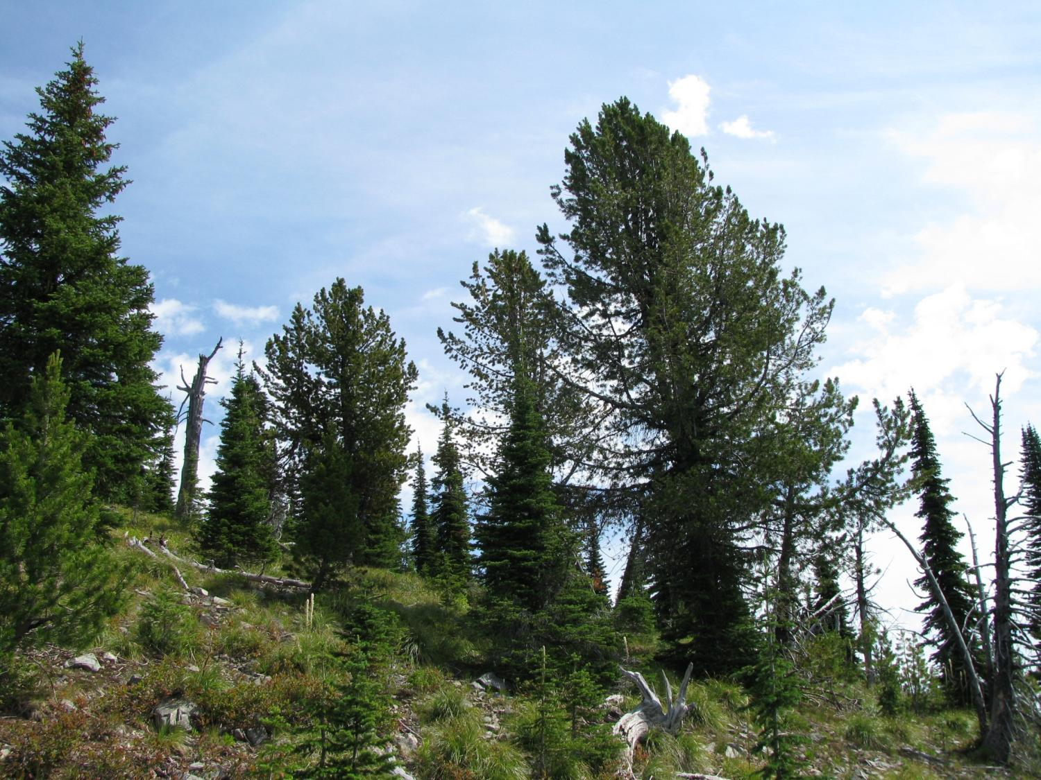
Whitebark Pine Health
(Pinus albicaulis)
Increasing demand for planting
  Forest industry
  Mining industry
  First Nations
  Parks
Harvested
Keystone species, supporting grizzly bears and others.
First western tree on Endangered List (SARA, June 2012)
Notes:
Endangered but part of the working forest.

Slide 13
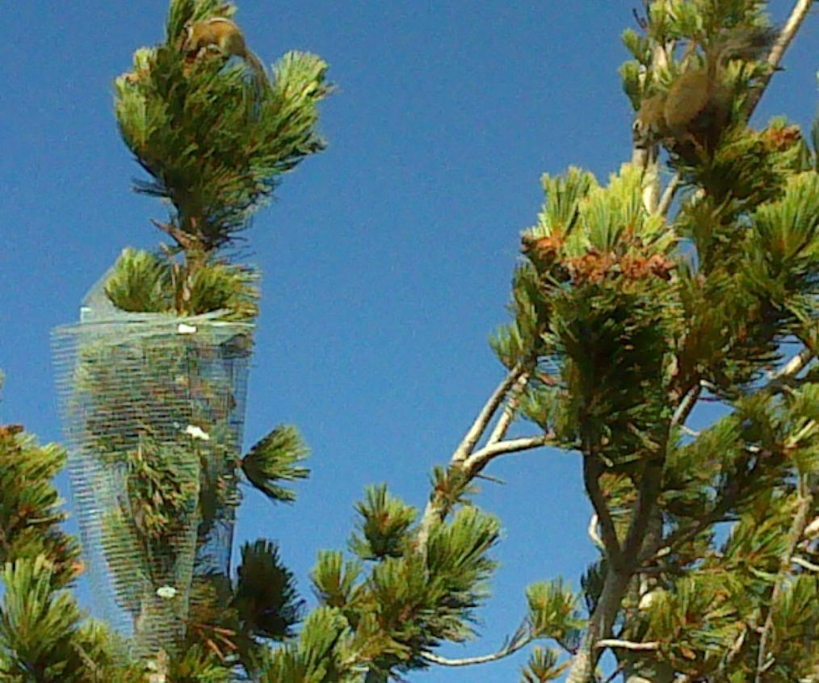
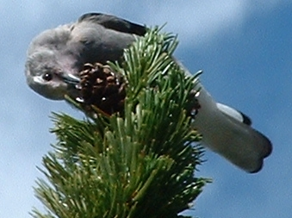
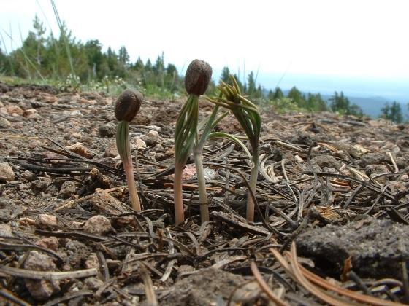
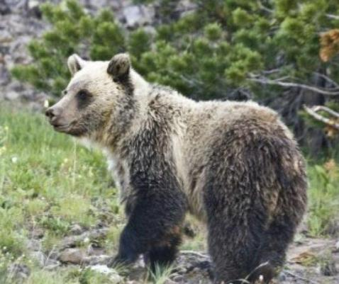
Seeds: important wildlife food
Birds: 6 families, 13 species
Small Mammals: 2 families, 8+ species
Large Mammals: 1 family, 2 species: Grizzly and black bears
Notes:
Clark’s nutcracker: mutualism

Slide 14
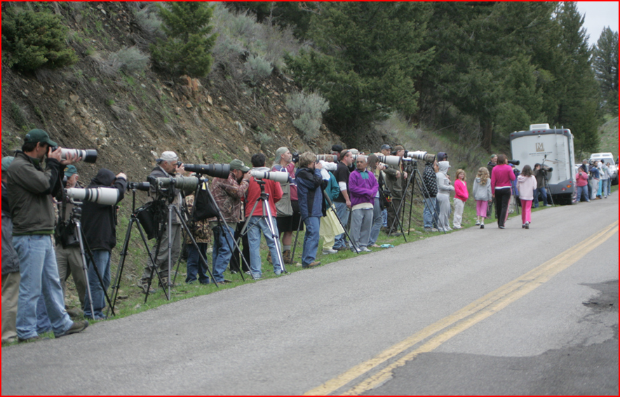
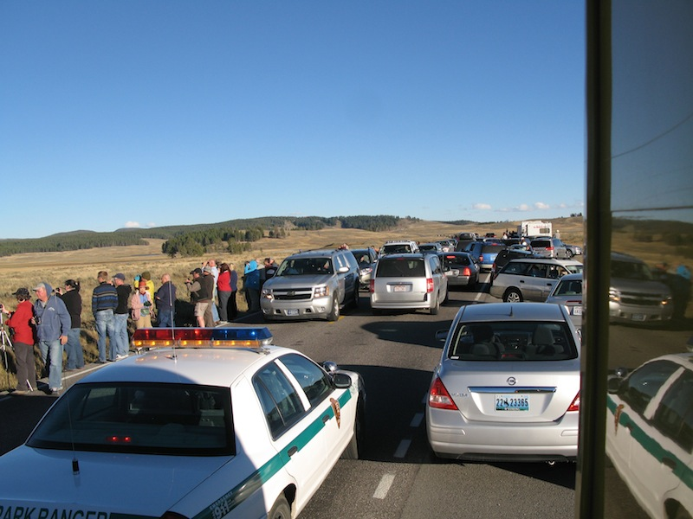

Slide 15
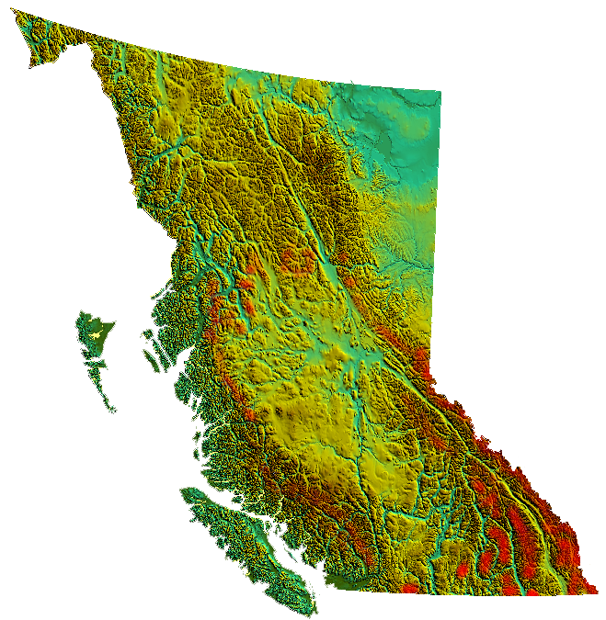

Slide 16
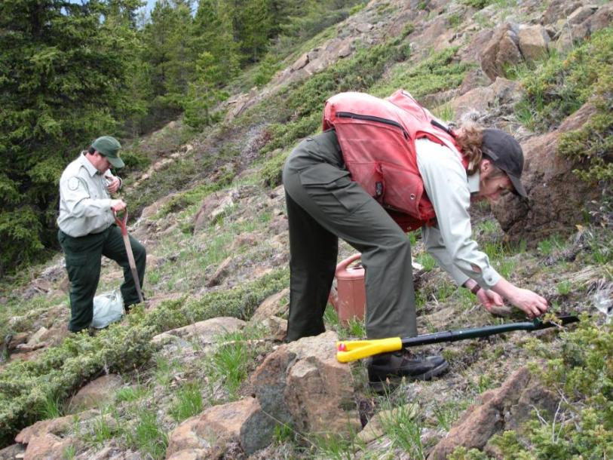
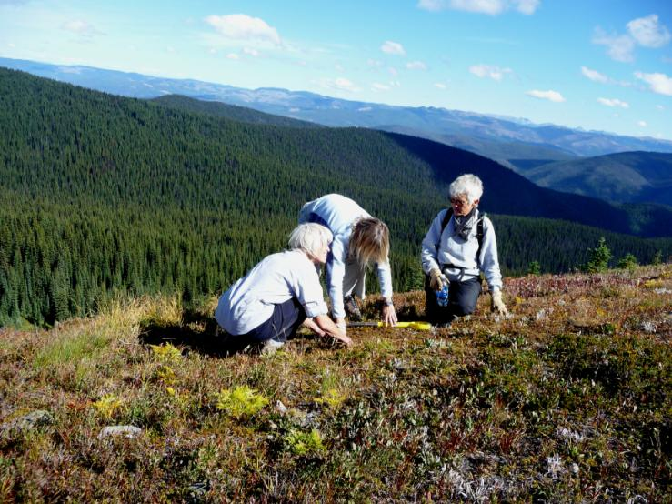
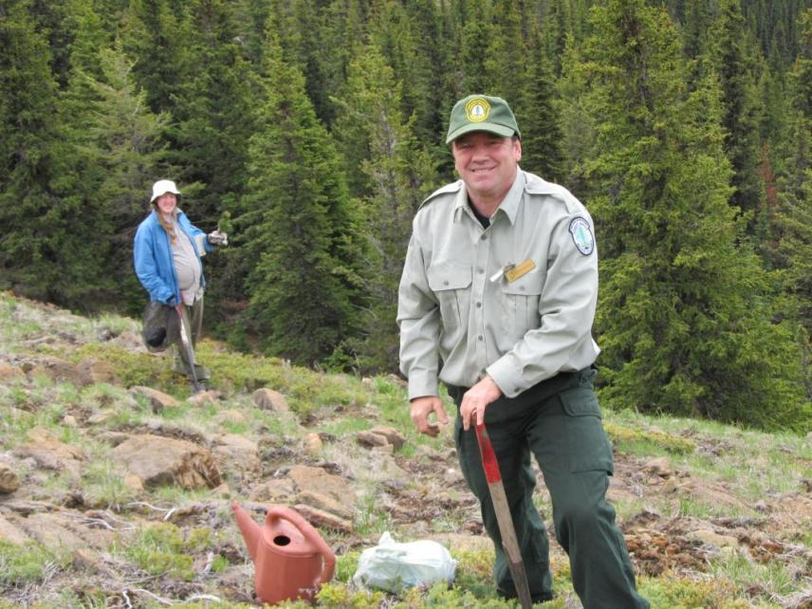
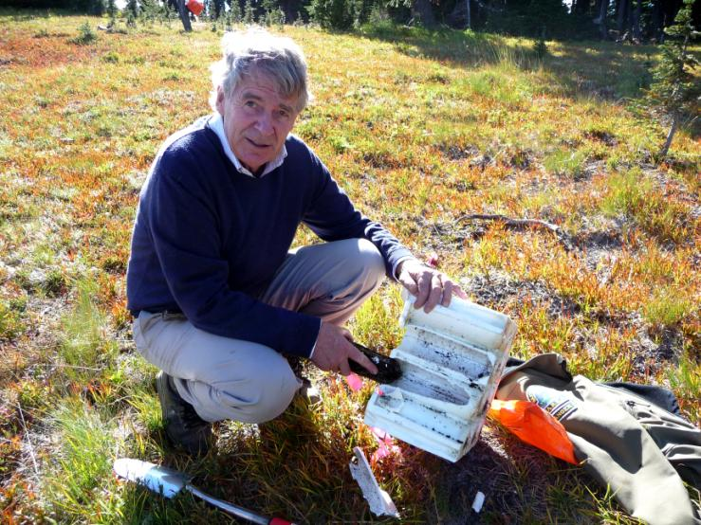
Insert tree planting photo
Notes:
Demand from industry is exceding supply

Slide 17
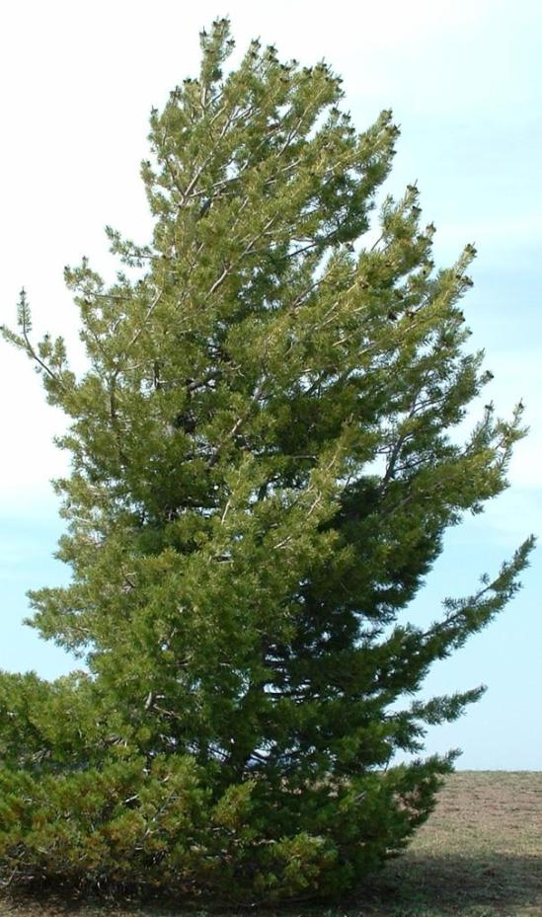
Disease Resistence Screening
Repeated Observation
Selection & Collection
Propagation & Rearing
Inoculation
Disease Resistant Trees

Slide 18
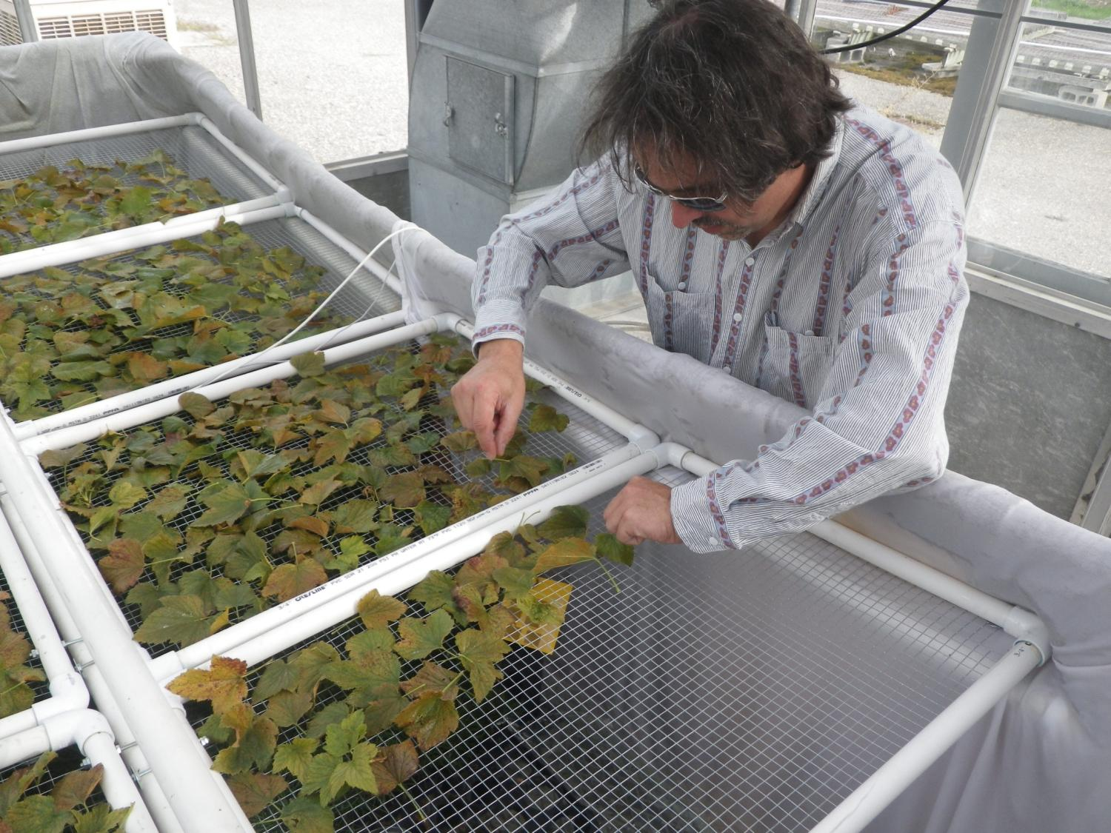
Inoculations
Kalamalka Research Centre (BC)
Dorena Tree Improvement Center (USFS)
Field Trials (Kootenays)
Beginning 2013 - 2014
Notes:
White Pine Program
CBT , Shell Oil, partnering with CFS, UBC, and USFS
Laying the groundwork – to open up supply, AND merge with Canadian Recovery Plan. Can Not sustain wbp without this.

Slide 19
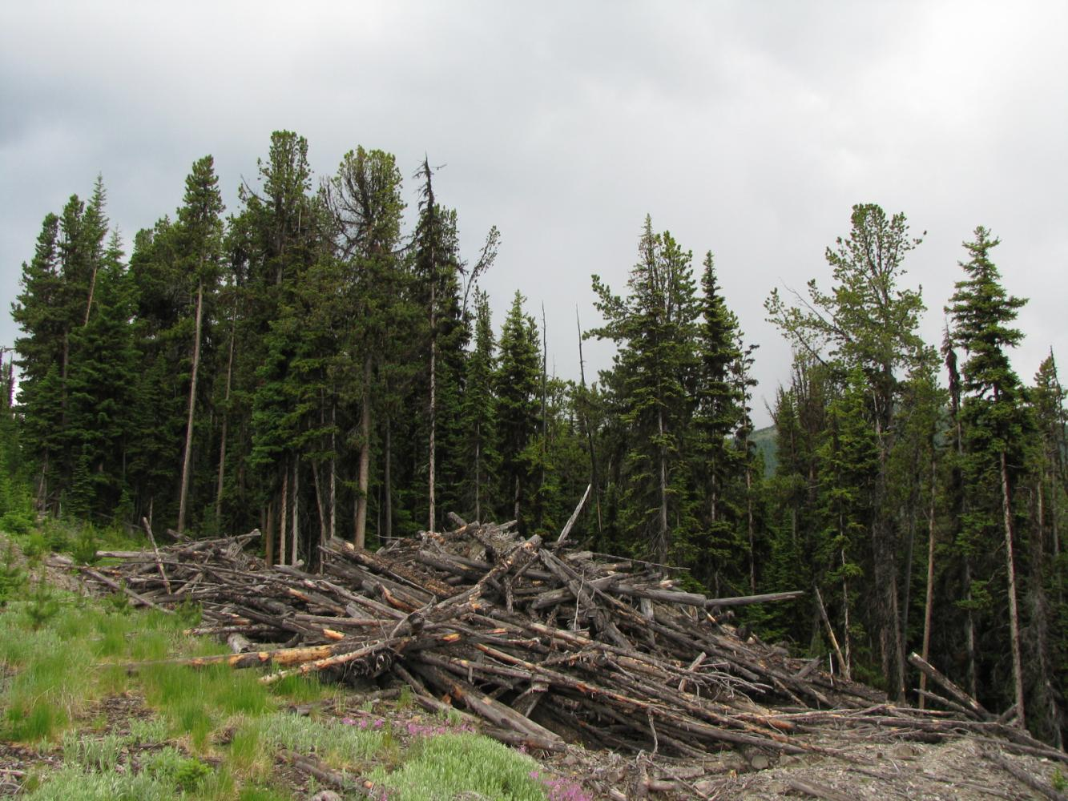
First western tree on Endangered List (SARA, June 2012)
Notes:
Logging can actually help wbp

Slide 20
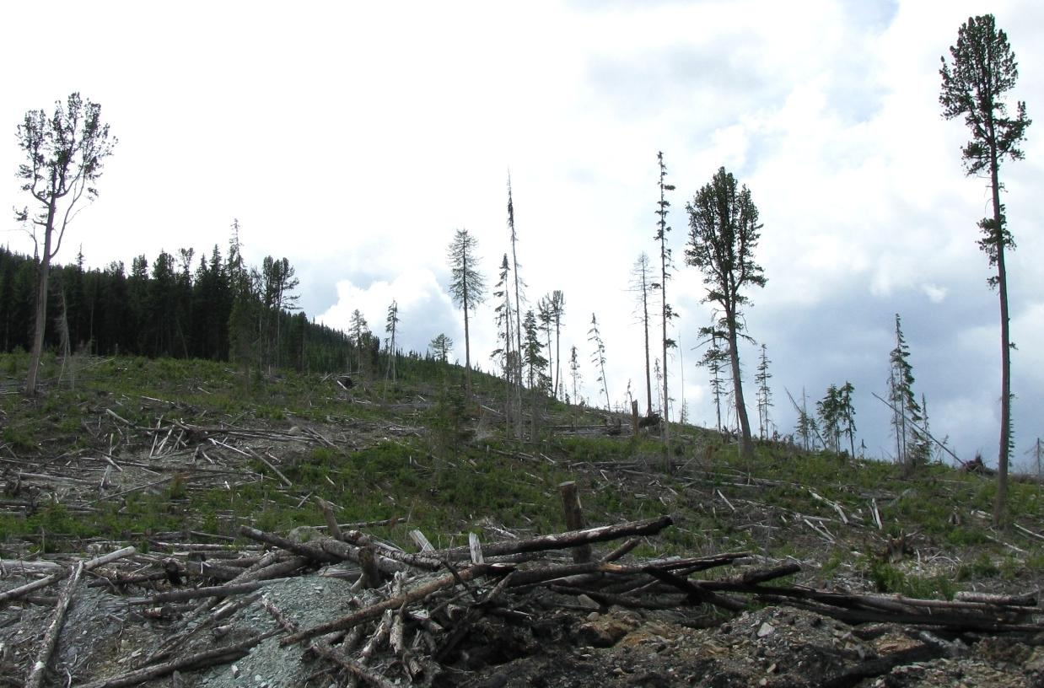
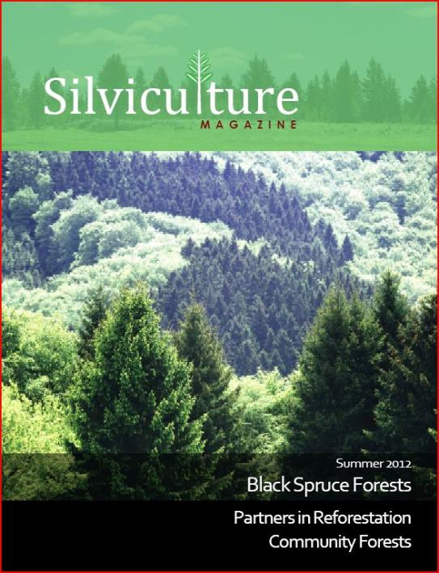
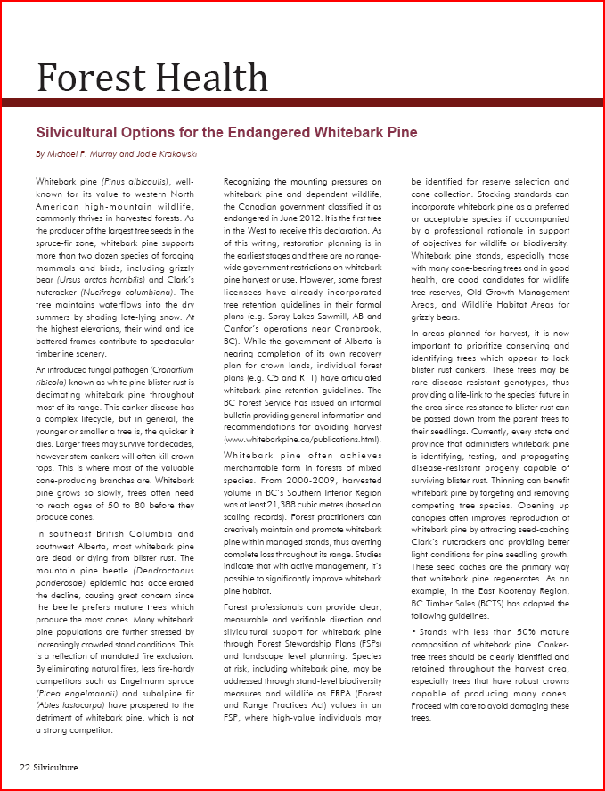
Notes:
Also BCTS & Canfor

Slide 21
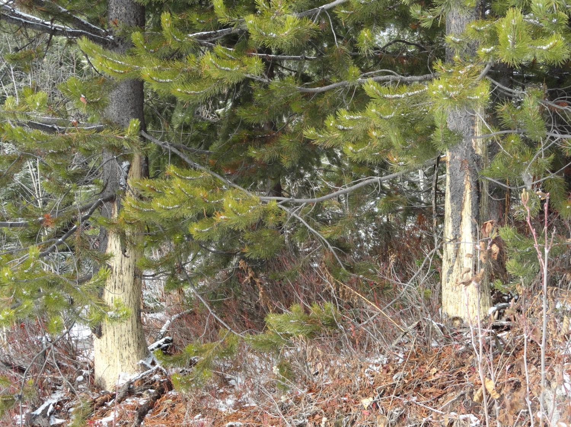
2-4% of trees observed (2008 SDM, 2012 YSM)
> 50% in some pine plantations.

Slide 22
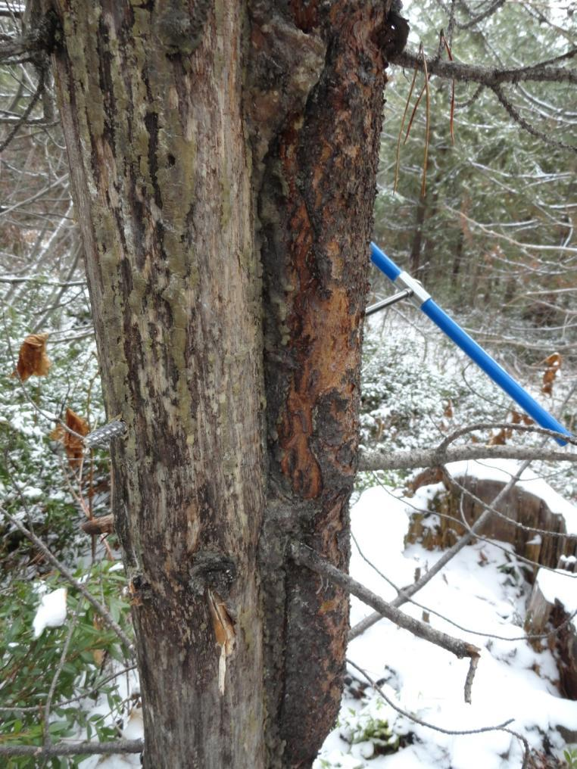
Lodgepole Pine
Plantation ages were between 14-24 years
Three Plantations
Recorded: % Circumference Removed and Vertical Extent

Slide 23
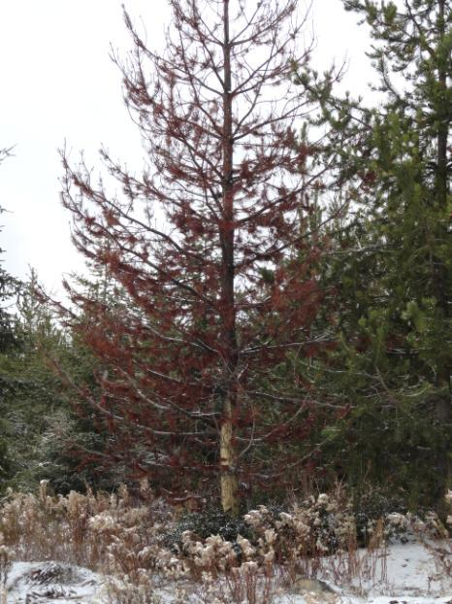
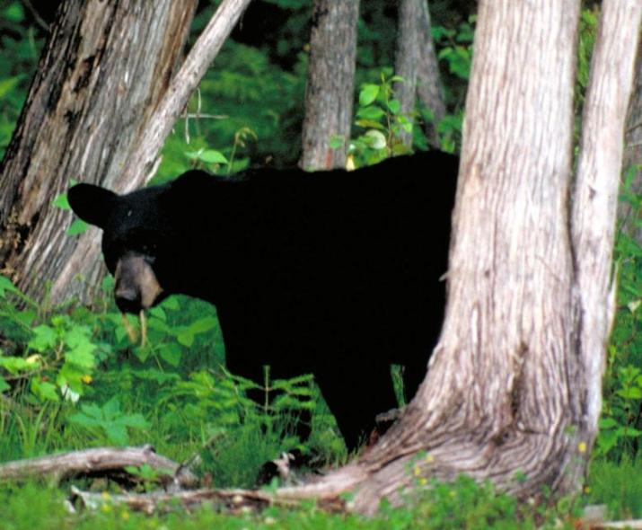
Must remove >70%-circumference of tree cambium

Slide 24
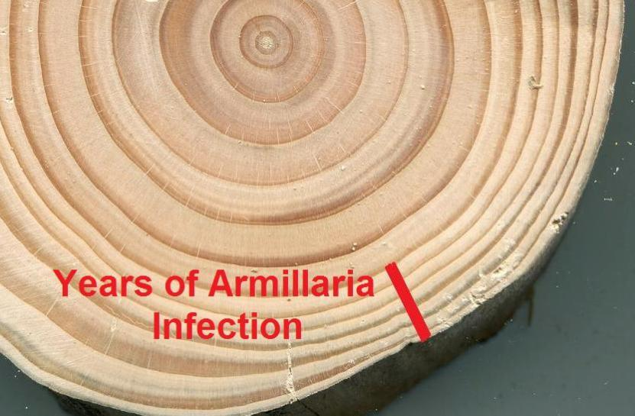
Notes:
“Signature”

Slide 25
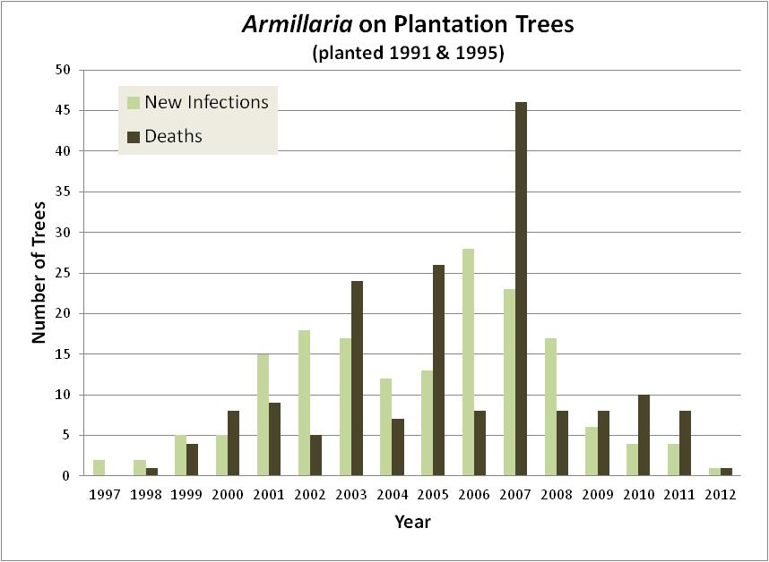

Slide 26
2013/14
Provide Assistance Where Needed
Root Disease Trial Analysis
Continue Rust Screening
White Pine Trials (resistance and pruning)
Long-term Site Productivity Network (LTSP)
Long-term Forest Health Plots: Whitebark Pine
Bear Damage
Climate Change (e.g. Birch Decline)?

Slide 27
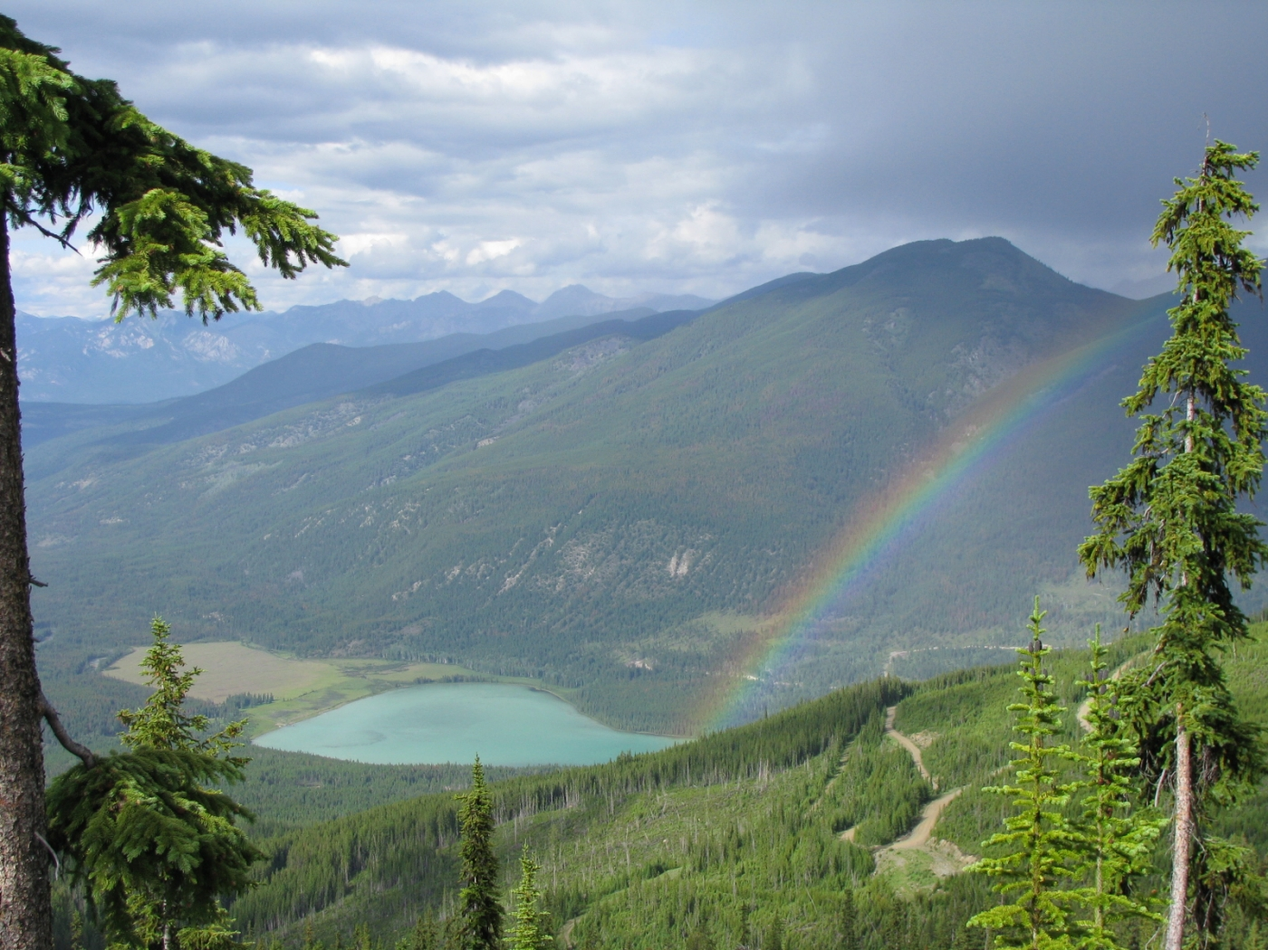
michael.murray@gov.bc.ca
Notes:
White tail Lk

